Slide 1
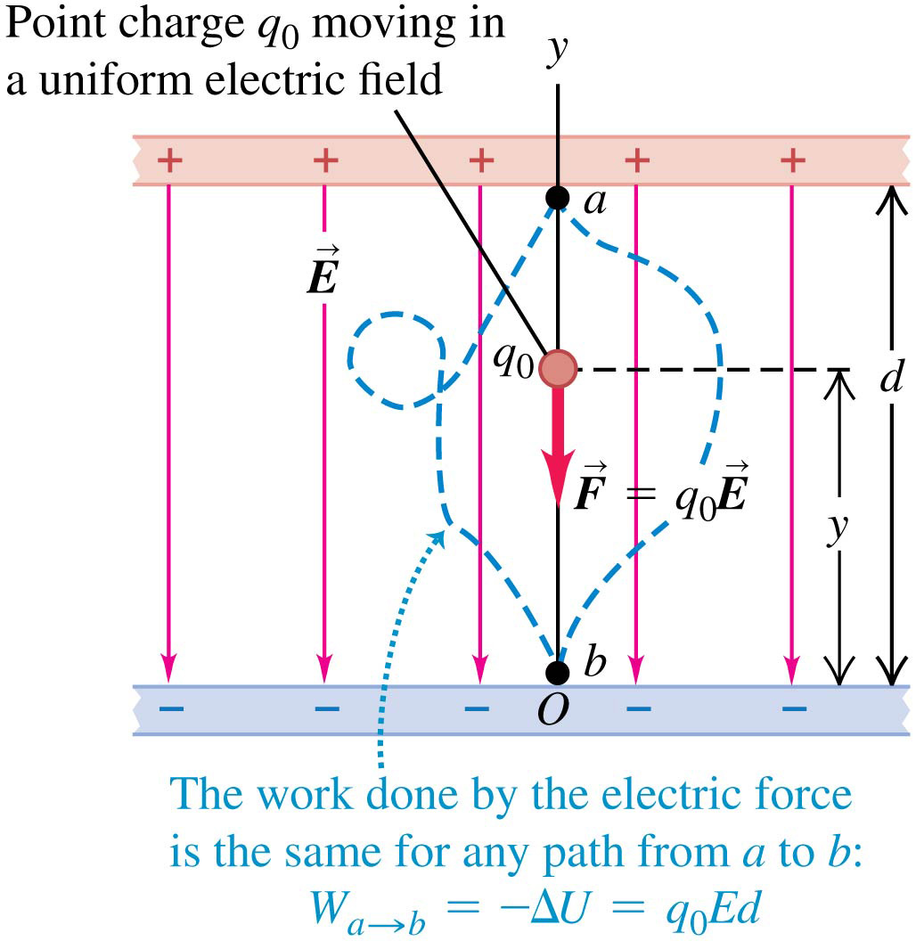
Electric potential energy in a uniform field
In the figure, a pair of charged parallel metal plates sets up a uniform, downward electric field.
The field exerts a downward force on a positive test charge.
As the charge moves downward from point a to point b, the work done by the field is independent of the path the particle takes.

Slide 2
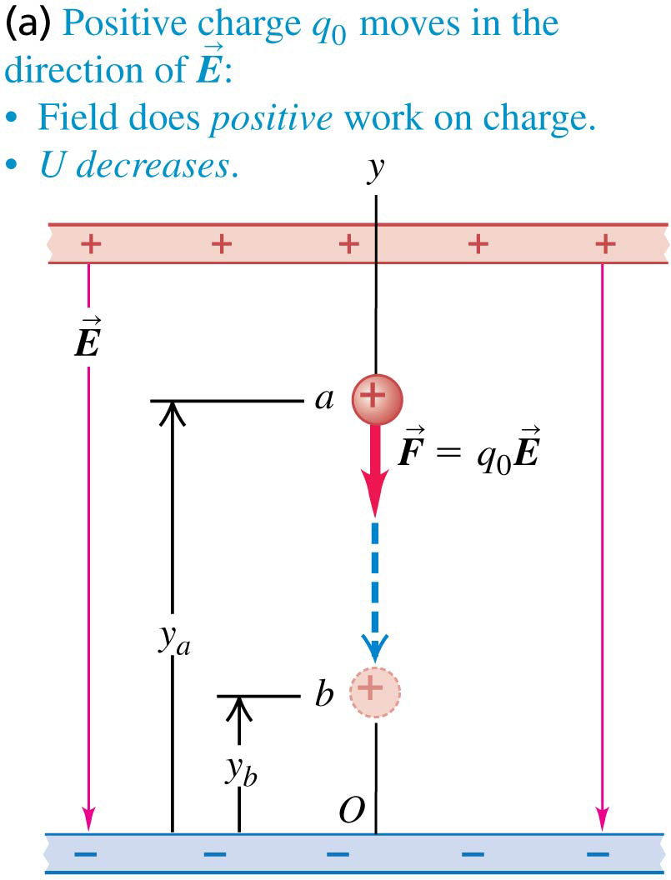
A positive charge moving in a uniform field
If the positive charge moves in the direction of the field, the field does positive work on the charge.
The potential energy decreases.

Slide 3
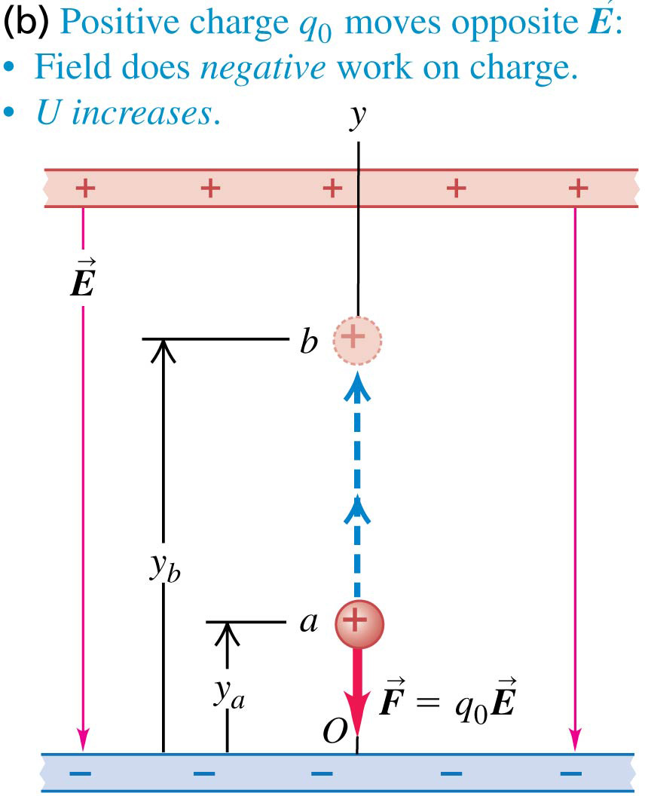
A positive charge moving in a uniform field
If the positive charge moves opposite the direction of the field, the field does negative work on the charge.
The potential energy increases.

Slide 4
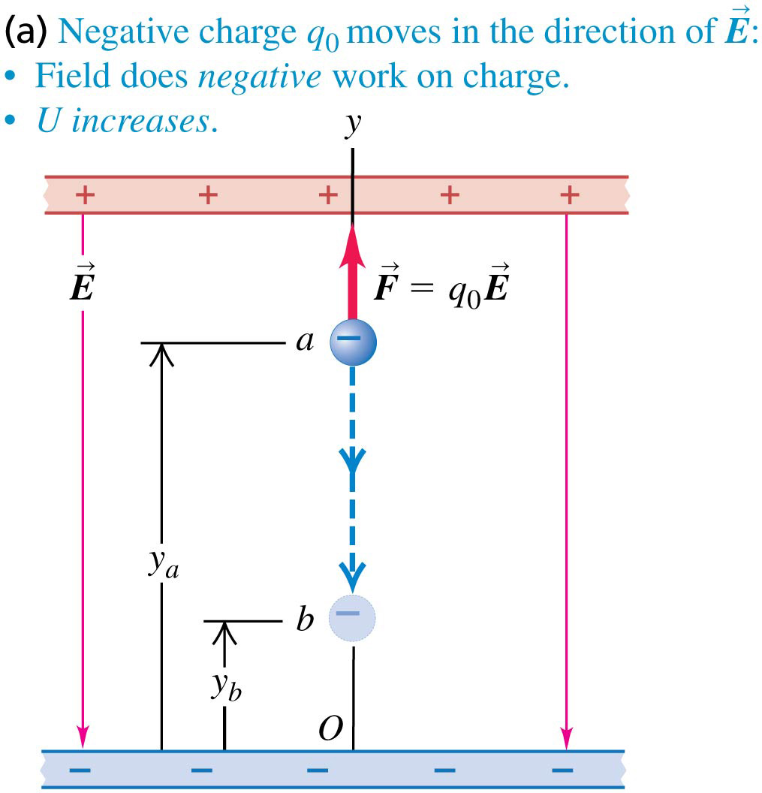
A negative charge moving in a uniform field
If the negative charge moves in the direction of the field, the field does negative work on the charge.
The potential energy increases.

Slide 5
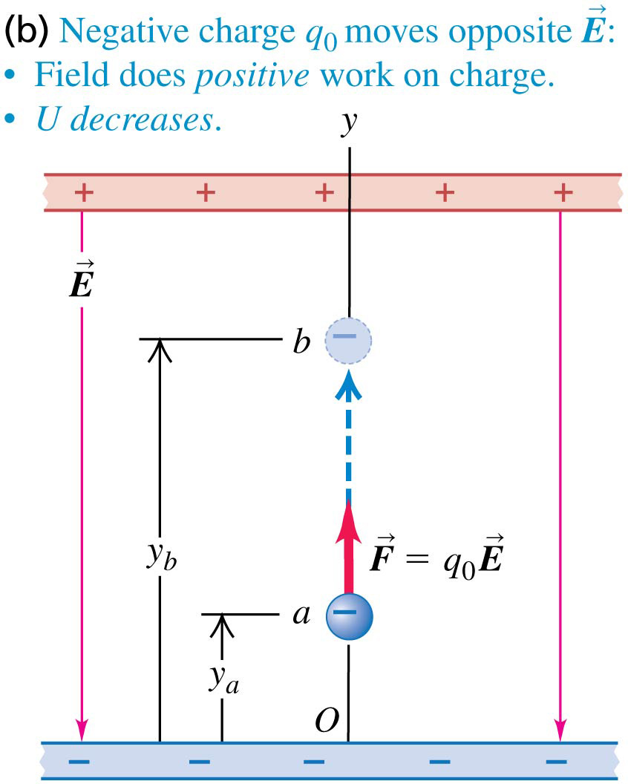
A negative charge moving in a uniform field
If the negative charge moves opposite the direction of the field, the field does positive work on the charge.
The potential energy decreases.

Slide 6
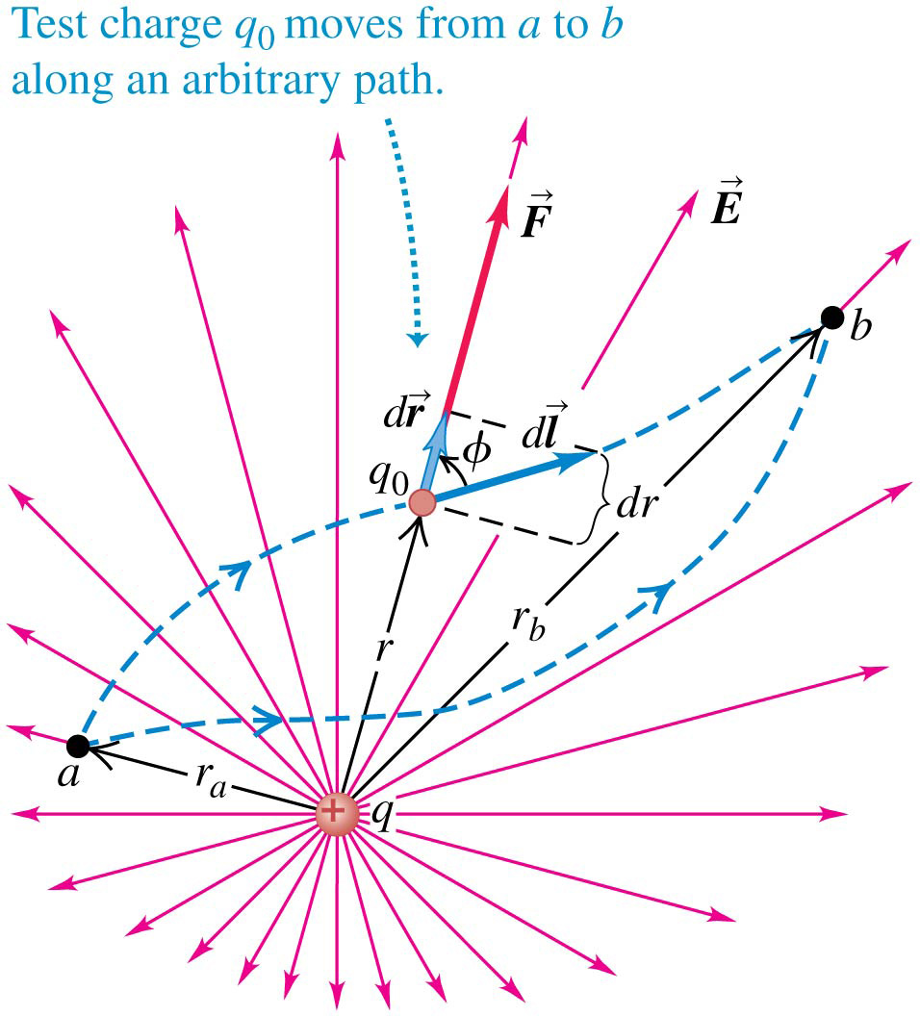
Electric potential energy of two point charges
The work done by the electric field of one point charge on another does not depend on the path taken.
Therefore, the electric potential energy only depends on the distance between the charges.

Slide 7
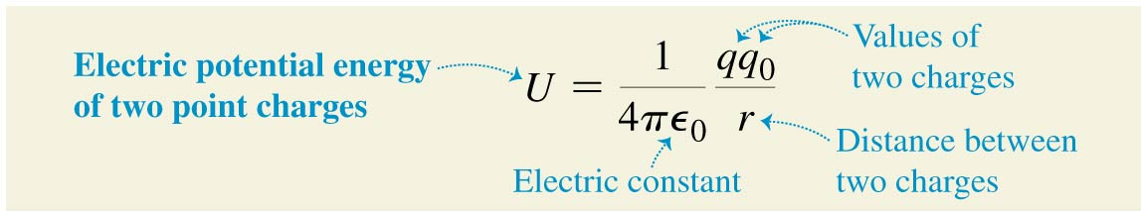
Electric potential energy of two point charges
The electric potential energy of two point charges only depends on the distance between the charges.
This equation is valid no matter what the signs of the charges are.
Potential energy is defined to be zero when the charges are infinitely far apart.

Slide 8
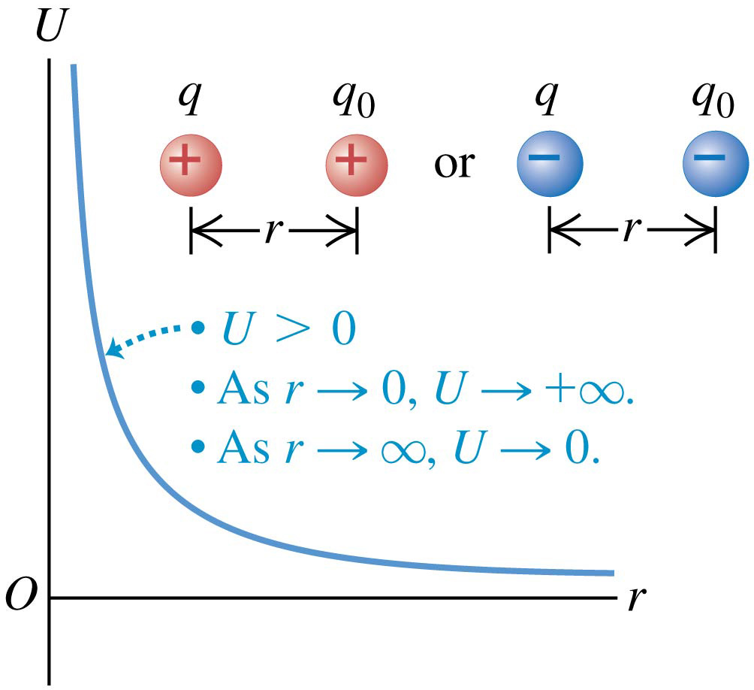
Graphs of the potential energy
If two charges have the same sign, the interaction is repulsive, and the electric potential energy is positive.

Slide 9
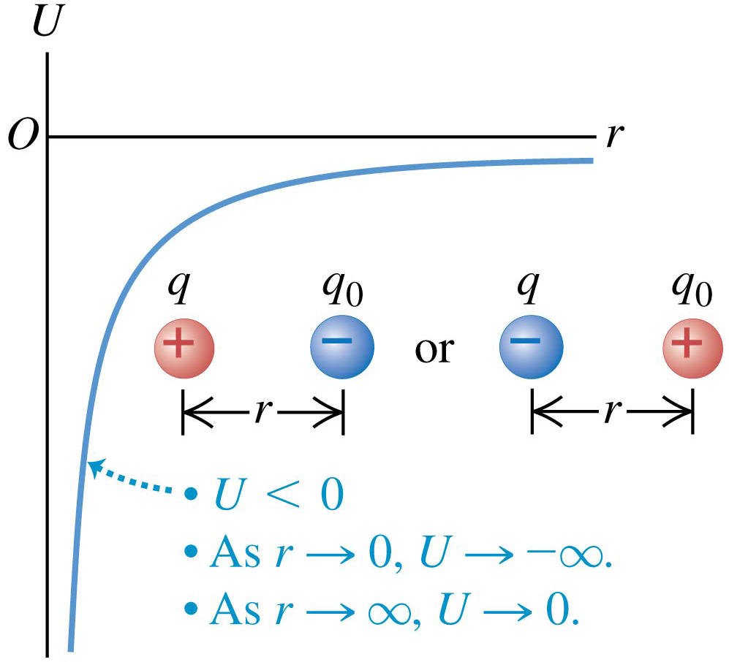
Graphs of the potential energy
If two charges have opposite signs, the interaction is attractive, and the electric potential energy is negative.

Slide 10
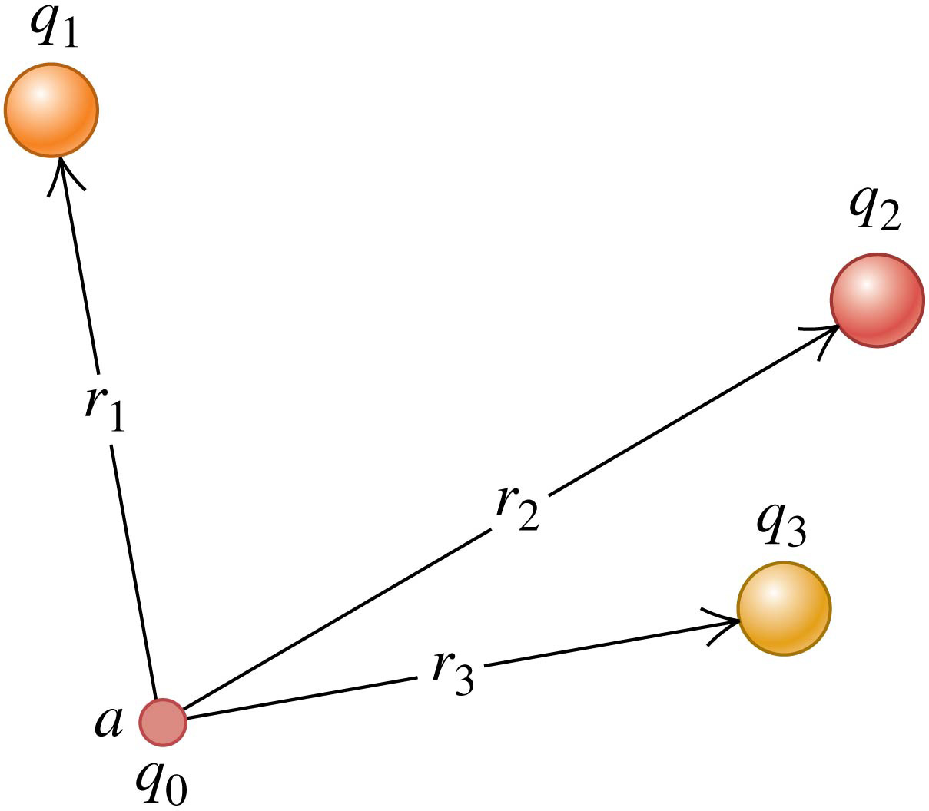
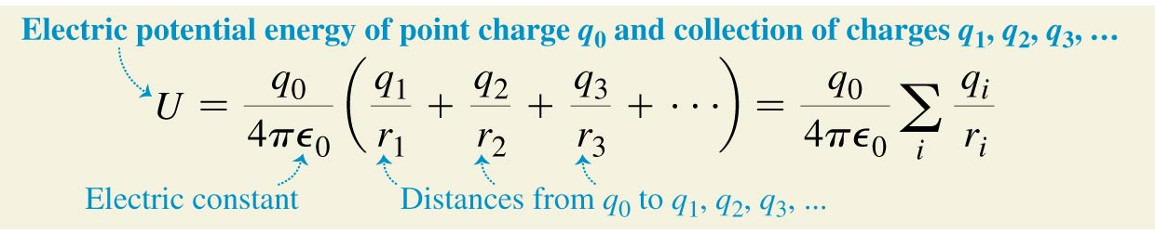
Electrical potential with several point charges
The potential energy associated with q₀ depends on the other charges and their distances from q₀.
The electric potential energy is the algebraic sum:

Slide 12
(a) Find the work that must be done by an external force to bring a third point charge q3 = +e from infinity to x = 2a.
Our negative result in part (b) means that the system has lower potential energy than it would if the three charges were infinitely far apart.

Slide 13
(b) Find the total potential energy of the system of three charges.

